Slide 1


Spring
Data access
Maksym Oleshchuk
Senior Software Engineer
July 18, 2017

Slide 2
CONTENTS
1
Data access introduction
2
JDBC and spring
3
DAO support
4
Transaction Management
5
ORM

Slide 3
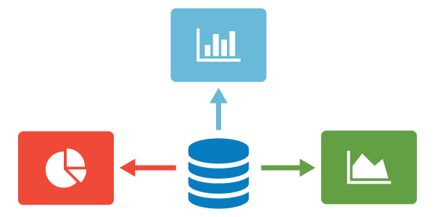
Intro
Notes:
This part of the reference documentation is concerned with data access and the interaction between the data access layer and the business or service layer.
Spring’s comprehensive transaction management support is covered in some detail, followed by thorough coverage of the various data access frameworks and technologies that the Spring Framework integrates with.

Slide 4
Pure JDBC
Get connection
Create stmt
Configure stmt
Handle exceptions
Get result
Exec stmt
Close stmt
Close connection

Slide 5
Spring JDBC
Action | Spring | You
Define connection parameters. |  | X
Open the connection. | X
Specify the SQL statement. |  | X
Declare parameters and provide parameter values |  | X
Prepare and execute the statement. | X
Set up the loop to iterate through the results (if any). | X
Do the work for each iteration. |  | X
Process any exception. | X
Handle transactions. | X
Close the connection, statement and resultset. | X
Notes:
The Spring Framework takes care of all the low-level details that can make JDBC such a tedious API to develop with.

Slide 6
Spring JDBC approach
JdbcTemplate
NamedParameterJdbcTemplate
SimpleJdbcInsert and SimpleJdbcCall
Notes:
You can choose among several approaches to form the basis for your JDBC database access. In addition to three flavors of the JdbcTemplate, a new SimpleJdbcInsert and SimplejdbcCall approach optimizes database metadata, and the RDBMS Object style takes a more object-oriented approach similar to that of JDO Query design. Once you start using one of these approaches, you can still mix and match to include a feature from a different approach. All approaches require a JDBC 2.0-compliant driver, and some advanced features require a JDBC 3.0 driver.
JdbcTemplate is the classic Spring JDBC approach and the most popular. This "lowest level" approach and all others use a JdbcTemplate under the covers.
NamedParameterJdbcTemplate wraps a JdbcTemplate to provide named parameters instead of the traditional JDBC "?"
SimpleJdbcInsert and SimpleJdbcCall optimize database metadata to limit the amount of necessary configuration.

Slide 7

JdbcTemplate
Notes:
The JdbcTemplate class is the central class in the JDBC core package. It handles the creation and release of resources, which helps you avoid common errors such as forgetting to close the connection. It performs the basic tasks of the core JDBC workflow such as statement creation and execution, leaving application code to provide SQL and extract results. The JdbcTemplate class executes SQL queries, update statements and stored procedure calls, performs iteration over ResultSets and extraction of returned parameter values. It also catches JDBC exceptions and translates them to the generic, more informative, exception hierarchy defined in theorg.springframework.dao package.
When you use the JdbcTemplate for your code, you only need to implement callback interfaces, giving them a clearly defined contract. The PreparedStatementCreator callback interface creates a prepared statement given a Connection provided by this class, providing SQL and any necessary parameters. The same is true for the CallableStatementCreator interface, which creates callable statements. The RowCallbackHandler interface extracts values from each row of a ResultSet.
The JdbcTemplate can be used within a DAO implementation through direct instantiation with a DataSource reference, or be configured in a Spring IoC container and given to DAOs as a bean reference.
The DataSource should always be configured as a bean in the Spring IoC container. In the first case the bean is given to the service directly; in the second case it is given to the prepared template.

Slide 8
JdbcTemplate in action

Slide 9
JdbcTemplate in action

Slide 10
JdbcTemplate in action

Slide 11
JdbcTemplate in action

Slide 12
JdbcTemplate in action

Slide 13
JdbcTemplate in action

Slide 14
JdbcTemplate in action

Slide 15
JdbcTemplate in action

Slide 16
JdbcTemplate in action
Notes:
Instances of the JdbcTemplate class are threadsafe once configured. This is important because it means that you can configure a single instance of a JdbcTemplateand then safely inject this shared reference into multiple DAOs (or repositories). The JdbcTemplate is stateful, in that it maintains a reference to a DataSource, but this state is not conversational state.

Slide 17
JdbcTemplate in action

Slide 18
JdbcTemplate in action

Slide 19
NamedParameterJdbcTemplate in action
Notes:
The NamedParameterJdbcTemplate class adds support for programming JDBC statements using named parameters, as opposed to programming JDBC statements using only classic placeholder ( '?') arguments. The NamedParameterJdbcTemplate class wraps a JdbcTemplate, and delegates to the wrapped JdbcTemplate to do much of its work. This section describes only those areas of the NamedParameterJdbcTemplate class that differ from the JdbcTemplate itself; namely, programming JDBC statements using named parameters.

Slide 20
NamedParameterJdbcTemplate in action
Notes:
Notice the use of the named parameter notation in the value assigned to the sql variable, and the corresponding value that is plugged into the namedParametersvariable (of type MapSqlParameterSource).
Alternatively, you can pass along named parameters and their corresponding values to a NamedParameterJdbcTemplate instance by using the Map-based style.The remaining methods exposed by the NamedParameterJdbcOperations and implemented by the NamedParameterJdbcTemplate class follow a similar pattern and are not covered here.
The following example shows the use of the Map-based style.

Slide 21
NamedParameterJdbcTemplate in action
Notes:
Another SqlParameterSource implementation is the BeanPropertySqlParameterSource class. This class wraps an arbitrary JavaBean (that is, an instance of a class that adheres to the JavaBean conventions), and uses the properties of the wrapped JavaBean as the source of named parameter values.

Slide 22
NamedParameterJdbcTemplate in action
Notes:
Another SqlParameterSource implementation is the BeanPropertySqlParameterSource class. This class wraps an arbitrary JavaBean (that is, an instance of a class that adheres to the JavaBean conventions), and uses the properties of the wrapped JavaBean as the source of named parameter values.

Slide 23

Connections

Slide 24
Connections
Notes:
Spring obtains a connection to the database through a DataSource. A DataSource is part of the JDBC specification and is a generalized connection factory. It allows a container or a framework to hide connection pooling and transaction management issues from the application code. As a developer, you need not know details about how to connect to the database; that is the responsibility of the administrator that sets up the datasource. You most likely fill both roles as you develop and test code, but you do not necessarily have to know how the production data source is configured.
When using Spring’s JDBC layer, you obtain a data source from JNDI or you configure your own with a connection pool implementation provided by a third party. Popular implementations are Apache Jakarta Commons DBCP and C3P0. Implementations in the Spring distribution are meant only for testing purposes and do not provide pooling.
This section uses Spring’s DriverManagerDataSource implementation, and several additional implementations are covered later.

Slide 25

Batching

Slide 26
Batching
Notes:
You accomplish JdbcTemplate batch processing by implementing two methods of a special interface, BatchPreparedStatementSetter, and passing that in as the second parameter in your batchUpdate method call. Use the getBatchSize method to provide the size of the current batch. Use the setValues method to set the values for the parameters of the prepared statement. This method will be called the number of times that you specified in the getBatchSize call. The following example updates the actor table based on entries in a list. The entire list is used as the batch in this example:

Slide 27
Batching
Notes:
Both the JdbcTemplate and the NamedParameterJdbcTemplate provides an alternate way of providing the batch update. Instead of implementing a special batch interface, you provide all parameter values in the call as a list. The framework loops over these values and uses an internal prepared statement setter. The API varies depending on whether you use named parameters. For the named parameters you provide an array of SqlParameterSource, one entry for each member of the batch. You can use the SqlParameterSource.createBatch method to create this array, passing in either an array of JavaBeans or an array of Maps containing the parameter values.
This example shows a batch update using named parameters:

Slide 28
Batching
Notes:
For an SQL statement using the classic "?" placeholders, you pass in a list containing an object array with the update values. This object array must have one entry for each placeholder in the SQL statement, and they must be in the same order as they are defined in the SQL statement.
The same example using classic JDBC "?" placeholders:

Slide 29
Batching
Notes:
The last example of a batch update deals with batches that are so large that you want to break them up into several smaller batches. You can of course do this with the methods mentioned above by making multiple calls to the batchUpdate method, but there is now a more convenient method. This method takes, in addition to the SQL statement, a Collection of objects containing the parameters, the number of updates to make for each batch and a ParameterizedPreparedStatementSetter to set the values for the parameters of the prepared statement. The framework loops over the provided values and breaks the update calls into batches of the size specified.
This example shows a batch update using a batch size of 100:

Slide 30
Batching
Notes:
The last example of a batch update deals with batches that are so large that you want to break them up into several smaller batches. You can of course do this with the methods mentioned above by making multiple calls to the batchUpdate method, but there is now a more convenient method. This method takes, in addition to the SQL statement, a Collection of objects containing the parameters, the number of updates to make for each batch and a ParameterizedPreparedStatementSetter to set the values for the parameters of the prepared statement. The framework loops over the provided values and breaks the update calls into batches of the size specified.
This example shows a batch update using a batch size of 100:

Slide 31
DAO support
Notes:
The Data Access Object (DAO) support in Spring is aimed at making it easy to work with data access technologies like JDBC, Hibernate, JPA or JDO in a consistent way. This allows one to switch between the aforementioned persistence technologies fairly easily and it also allows one to code without worrying about catching exceptions that are specific to each technology.

Slide 32
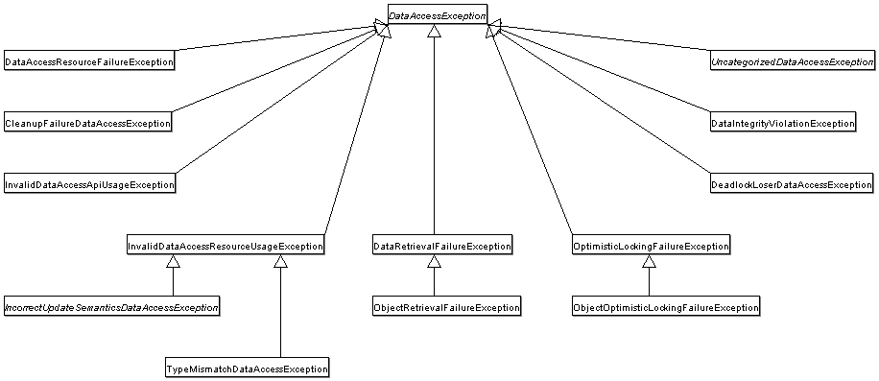
DAO support
Notes:
Spring provides a convenient translation from technology-specific exceptions like SQLException to its own exception class hierarchy with the DataAccessExceptionas the root exception. These exceptions wrap the original exception so there is never any risk that one might lose any information as to what might have gone wrong.
In addition to JDBC exceptions, Spring can also wrap Hibernate-specific exceptions, converting them to a set of focused runtime exceptions (the same is true for JDO and JPA exceptions). This allows one to handle most persistence exceptions, which are non-recoverable, only in the appropriate layers, without having annoying boilerplate catch-and-throw blocks and exception declarations in one’s DAOs. (One can still trap and handle exceptions anywhere one needs to though.) As mentioned above, JDBC exceptions (including database-specific dialects) are also converted to the same hierarchy, meaning that one can perform some operations with JDBC within a consistent programming model.
The above holds true for the various template classes in Springs support for various ORM frameworks. If one uses the interceptor-based classes then the application must care about handling HibernateExceptions and JDOExceptions itself, preferably via delegating to SessionFactoryUtils’ `convertHibernateAccessException(..) or convertJdoAccessException() methods respectively. These methods convert the exceptions to ones that are compatible with the exceptions in the org.springframework.dao exception hierarchy. As JDOExceptions are unchecked, they can simply get thrown too, sacrificing generic DAO abstraction in terms of exceptions though.
The exception hierarchy that Spring provides can be seen below. (Please note that the class hierarchy detailed in the image shows only a subset of the entireDataAccessException hierarchy.)

Slide 33
DAO support
Notes:
The last example of a batch update deals with batches that are so large that you want to break them up into several smaller batches. You can of course do this with the methods mentioned above by making multiple calls to the batchUpdate method, but there is now a more convenient method. This method takes, in addition to the SQL statement, a Collection of objects containing the parameters, the number of updates to make for each batch and a ParameterizedPreparedStatementSetter to set the values for the parameters of the prepared statement. The framework loops over the provided values and breaks the update calls into batches of the size specified.
This example shows a batch update using a batch size of 100:

Slide 34

Transaction management

Slide 35
PlatformTransactionManager

Slide 36
TransactionStatus

Slide 37
TransactionDefinition
Isolation: The degree to which this transaction is isolated from the work of other transactions.
Propagation: Typically, all code executed within a transaction scope will run in that transaction. However, you have the option of specifying the behavior in the event that a transactional method is executed when a transaction context already exists.
Timeout: How long this transaction runs before timing out and being rolled back automatically by the underlying transaction infrastructure.
Read-only status: A read-only transaction can be used when your code reads but does not modify data. Read-only transactions can be a useful optimization in some cases, such as when you are using Hibernate.

Slide 38
DataSourceTransactionManager

Slide 39
Declarative way
Notes:
Examine the preceding configuration. You want to make a service object, the fooService bean, transactional. The transaction semantics to apply are encapsulated in the <tx:advice/> definition. The <tx:advice/> definition reads as "…​ all methods on starting with 'get' are to execute in the context of a read-only transaction, and all other methods are to execute with the default transaction semantics". The transaction-manager attribute of the <tx:advice/> tag is set to the name of thePlatformTransactionManager bean that is going to drive the transactions, in this case, the txManager bean.
The <aop:config/> definition ensures that the transactional advice defined by the txAdvice bean executes at the appropriate points in the program. First you define a pointcut that matches the execution of any operation defined in the FooService interface ( fooServiceOperation). Then you associate the pointcut with the txAdvice using an advisor. The result indicates that at the execution of a fooServiceOperation, the advice defined by txAdvice will be run.
The expression defined within the <aop:pointcut/> element is an AspectJ pointcut expression; see Chapter 11, Aspect Oriented Programming with Spring for more details on pointcut expressions in Spring.

Slide 40
Other Declarative way

Slide 41
Other Declarative way
Notes:
In addition to the XML-based declarative approach to transaction configuration, you can use an annotation-based approach. Declaring transaction semantics directly in the Java source code puts the declarations much closer to the affected code. There is not much danger of undue coupling, because code that is meant to be used transactionally is almost always deployed that way anyway.

Slide 42
Programmatic way

Slide 43
Programmatic way

Slide 44
Programmatic way
Notes:
Programmatic transaction management is usually a good idea only if you have a small number of transactional operations. For example, if you have a web application that require transactions only for certain update operations, you may not want to set up transactional proxies using Spring or any other technology. In this case, using theTransactionTemplate may be a good approach. Being able to set the transaction name explicitly is also something that can only be done using the programmatic approach to transaction management.
On the other hand, if your application has numerous transactional operations, declarative transaction management is usually worthwhile. It keeps transaction management out of business logic, and is not difficult to configure. When using the Spring Framework, rather than EJB CMT, the configuration cost of declarative transaction management is greatly reduced.

Slide 45

ORM

Slide 46
QUESTIONS

